Slide 1
Fronting Tomcat With Apache V0.1 – 2011-01-27
Nguyễn Bá Thành
Software Manager, Game Platform & Integration

Slide 2
Why?
Best Practice
Scalability
Security
Load Balancing
Failover

Slide 3
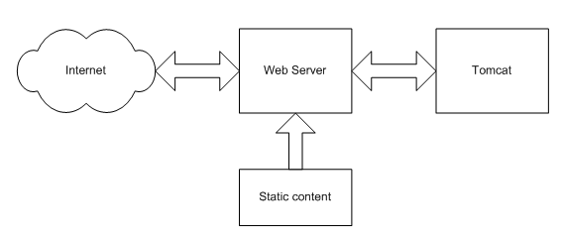
Free Tomcat From Serving Static Content
Notes:
Ref: http://people.apache.org/~mturk/docs/article/ftwai.html

Slide 4
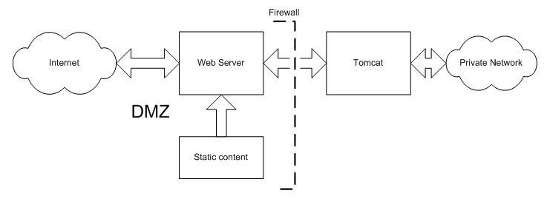
Security
Notes:
Ref: http://people.apache.org/~mturk/docs/article/ftwai.html

Slide 5
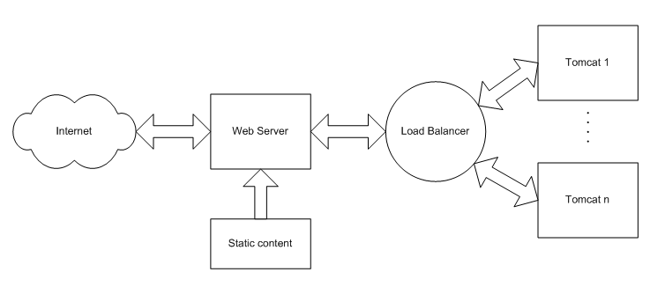
Load Balancing
Notes:
Ref: http://people.apache.org/~mturk/docs/article/ftwai.html

Slide 6
Load Balancing (cont)
worker.node1.type=ajp13
worker.node1.host=10.0.0.10
worker.node1.lbfactor=1
worker.node2.type=ajp13
worker.node2.host=10.0.0.11
worker.node2.lbfactor=1
worker.node3.type=ajp13
worker.node3.host=10.0.0.12
worker.node3.lbfactor=1
worker.list=lbworker
worker.lbworker.type=lb
worker.lbworker.balance_workers=node1,node2,node3
Notes:
Ref:
http://people.apache.org/~mturk/docs/article/ftwai.html
Worker types: can be one of ajp13, ajp14, jni, lb or status (jni is depracated!)

Slide 7
Failover
worker.list=lbworker
worker.lbworker.type=lb
worker.lbworker.balance_workers=node1,node2,node3,node4
worker.retries=4
Notes:
Ref: http://people.apache.org/~mturk/docs/article/ftwai.html

Slide 8
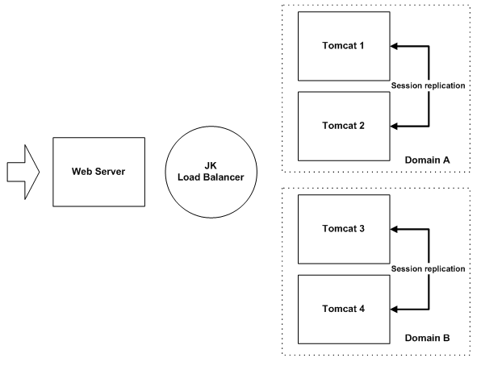
Domain Clustering Model
Notes:
Ref: http://people.apache.org/~mturk/docs/article/ftwai.html

Slide 9
Domain Clustering Model (cont)
worker.node1.type=ajp13
worker.node1.domain=A
worker.node2.type=ajp13
worker.node2.domain=A
worker.node3.type=ajp13
worker.node3.domain=B
worker.node4.type=ajp13
worker.node4.domain=B
worker.list=lbworker
worker.lbworker.type=lb
worker.lbworker.balance_workers=node1,node2,node3,node4
Notes:
Ref: http://people.apache.org/~mturk/docs/article/ftwai.html

Slide 10
Thank You

